Slide 1
PBIS
Nole Expectations | Salem High School
Tayla Reid

Slide 2
Positive behavioral interventions and supports
What is pbis:
Ongoing implementation of an evidence-based, data-driven, purpose driven, framework:
think
What structure do we want to build in order to improve our Salem climate and address the academic needs of our Salem community?
What type of structure will house positive relationship building among faculty, staff, students, and stakeholders?
How can I be an influential member of the SHS PBIS team?

Slide 3
PBIS PURPOSE | Salem High School
The purpose of the Salem High School PBIS team is to build and maintain a school climate where all stakeholders are valued and empowered.
This will be achieved by improving the social, emotional, and academic outcomes of our students as they uphold the expectations of- never giving up being on-time, leaders who are engaged and safe.

Slide 4
PBIS N ever give up being O n time L eaders E ngaged S afe EXPECTATIONS
All inclusive!

Slide 5
PBIS NOLES EXPECTATIONS IN A VIRTUAL WORLD

Slide 6
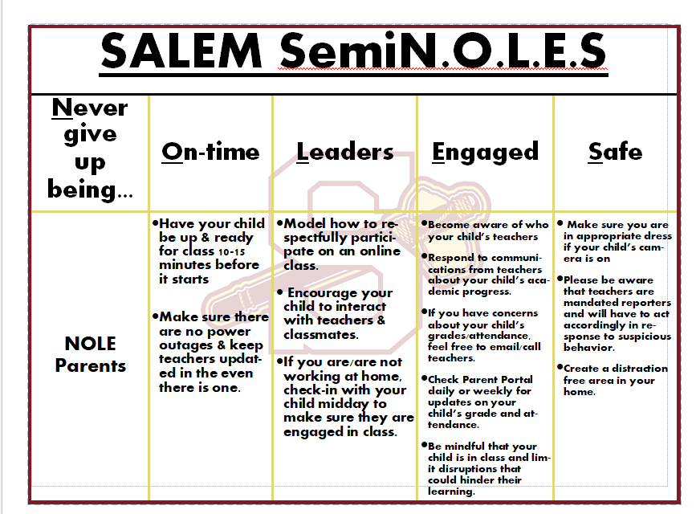
PBIS NOLES EXPECTATIONS IN A VIRTUAL WORLD

Slide 7
PBIS focus subjects| 20-21
MONTHLY REINCEFORCEMENT OF EXPECTATIONS
AUG/JAN | SEPT/FEB | OCT/MARCH | NOV/APRIL | DEC/MAY
Never Give Up | On-Time | Leaders | Engaged | Safe

Slide 8
AND HOW WE CELEBRATE OUR STUDENTS

Slide 9
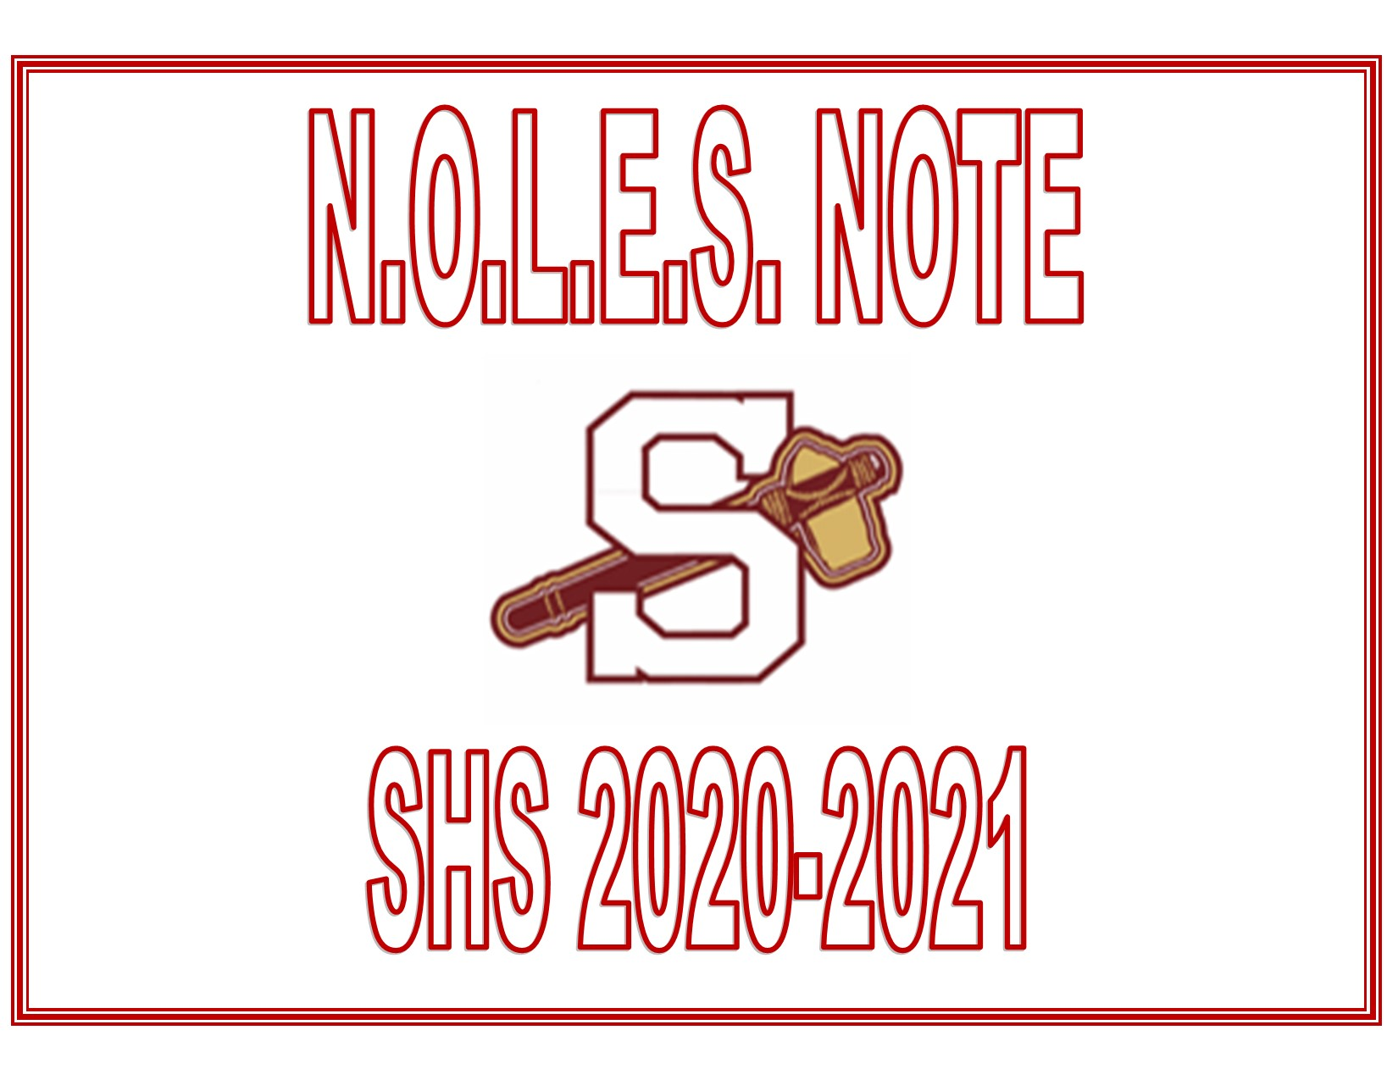

Slide 10
The Trick Is On YOU!
How Many Treats Can You Find?
SHS October PBIS Celebration!
Scavenger Hunt
This Photo by Unknown Author is licensed under CC BY

Slide 11
SHS NOVEMBER PBIS CELEBRATION!
Songs about Friendship!
Songs that Engage Friends!
TV Shows/Movies About Friendship!
Winners Challenge!
Acknowledging Engaged leaders!

Slide 12
QUESTIONS?

Slide 13
SHS Safety Plan Spring 2021
The health and safety of students and staff remain the top priority of Rockdale County Public Schools as we transition back to school buildings using a hybrid model for teaching and learning. We will continue to monitor the COVID-19 data in our community and will make changes, as necessary. We believe that closely following the recommended guidelines of the Centers for Disease Control (CDC) and the Gwinnett, Newton, Rockdale (GNR) regional public health department will reduce the spread of illness. However, it will take the efforts of all parents, students, staff, and community members to wear a mask or face covering, wash hands frequently, and watch your distance by keeping at least 6 feet apart. Together, we will stay healthy and thrive!
Current Return Timetable
January 19th Administration return to the building in a Hybrid State
February 1st Faculty and Staff report back to the building full-time
February 22nd Students report back in a Hybrid State
Campus Wide Prevention
Screening Protocols Classrooms
Personal Health and Front Entrance Special Education
Daily Cleaning Practices Band, Chorus and Drama
School Supplies and Materials Cafeteria
Substitute Teachers Hallways
Large gatherings and activities Water Fountains
Visitors Library
Buses Athletics
Clubs ROTC
Safety
First

Slide 14
QUESTIONS?

